Slide 1







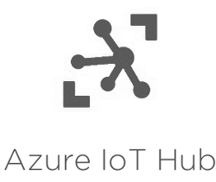


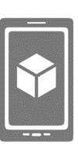



Devices
Connectivity & Management
Analytics
Storage
Tools
Presentation
Azure SQL DB
Azure ML
Power BI
Table/Blob Storage
Stream Analytics
App&Mobile service

